Slide 1

Understanding Transitive Closure and Warshall's Algorithm
Mazen Ashraf Mohamed Ebrahim
221875

Slide 2
Definition of Transitive Closure
What is Transitive Closure?
Normal Definition: The transitive closure of a graph refers to the identification and inclusion of all possible indirect relationships between nodes based on the direct relationships already present in the graph.
Importance in Graph Theory and Real-world Applications:
Real-world Scenarios: Examples include social networks where transitive closure helps identify indirect connections between individuals, or in logistics to determine all possible routes between locations for efficient transportation planning.

Slide 3
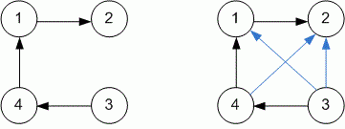
Explaining Transitive Closure

Slide 4
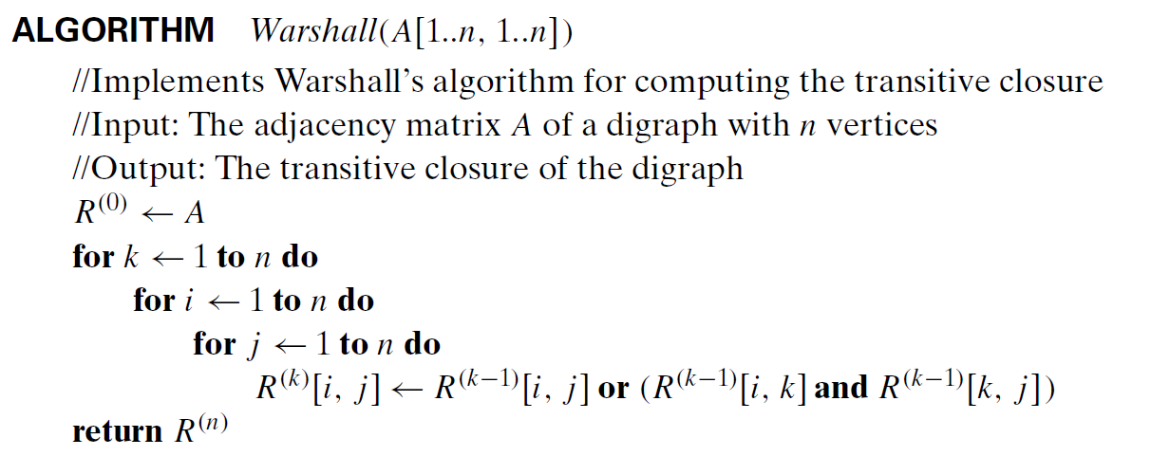
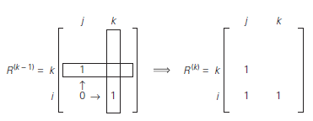
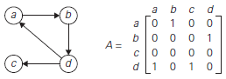
Introduction to Warshall's Algorithm

